Slide 1
Optical Character Recognition (OCR) for Text Extraction and Verification
By Neil Emmanuel Mathias and Shantanu V

Slide 2
Core Feature: Intelligent Text Extraction
Function: Convert diverse scanned documents into structured, usable data.
* Multi-Engine OCR: Uses TrOCR (Printed/Handwritten) and Tesseract (Multilingual) for best-in-class accuracy.
* Advanced Preprocessing: Automatic deskewing, denoising, and border removal.
* Multi-Language Support: English, Hindi (Devanagari), and Arabic (RTL).
* Dynamic Field Identification: Pattern-based recognition; No fixed templates required (Partial Data Mapping).

Slide 3
Extraction in Action: Multi-Lingual & Diverse Documents
Document Versatility: Works with high-value documents.
* ID Cards: Aadhaar, PAN, Passport, Driver's License.
* Forms: Application and Registration Forms.
* Certificates: Degree, Diploma, and Birth Certificates.
* Supported Scripts: Latin (English) and Non-Latin (Hindi, Arabic).
* Key Advantage: System intelligently selects the best OCR engine (TrOCR/Tesseract) based on language and text type (printed vs. handwritten).

Slide 4
Core Feature: Data Verification & Scoring
Function: Cross-check extracted OCR data against submitted values for quality assurance.
Verification Output:
* Confidence Scoring: Field-by-field similarity scores and an overall confidence metric.
* Status Indicators: Clear status: Match, Partial Match, Mismatch, Not Found.
* Engine: Uses fuzzy matching (e.g., difflib, fuzzywuzzy) for robust comparison.
* Value Proposition: Reduces verification time and human error by providing objective accuracy metrics.

Slide 5
The Web Demo Interface:
Goal: Demonstrate the seamless end-to-end workflow to a user.
* Upload: Simple drag-and-drop for PDF/JPEG/PNG.
* Auto-Fill: Extracted data automatically populates digital form fields.
* Manual Correction: Allows users to correct OCR errors before final verification, creating a human-in-the-loop workflow.
* Verification Dashboard: Visually displays confidence scores and match status with color-coding.

Slide 6
Tech Stack
Category | Component | Description & Purpose
Backend API & Server | FastAPI | High-performance, asynchronous Python web framework for building the REST API (Extraction, Verification).
 | Uvicorn | ASGI server to run FastAPI, ensuring fast, concurrent handling of document upload requests.
Core OCR Engines | PyTorch & TrOCR | State-of-the-art Deep Learning framework and model (TrOCR) used for high-accuracy recognition of both printed and handwritten text.
 | Tesseract OCR | Classic, robust, open-source engine used for multilingual support (Hindi, Arabic) and as a highly reliable fallback engine.
Data Processing | OpenCV & Pillow | Libraries for image preprocessing (deskewing, denoising) and handling various document formats (PDF, JPEG, PNG).
 | fuzzywuzzy / difflib | Python libraries used in the Verification API to calculate text similarity and generate the confidence scores.
Frontend Demo | HTML / CSS / JS | Standard web technologies for the responsive, drag-and-drop user interface, form auto-filling, and visual verification dashboard.
Environment | Python 3.10+ | The core programming language leveraging its rich ecosystem of AI/ML libraries.

Slide 7
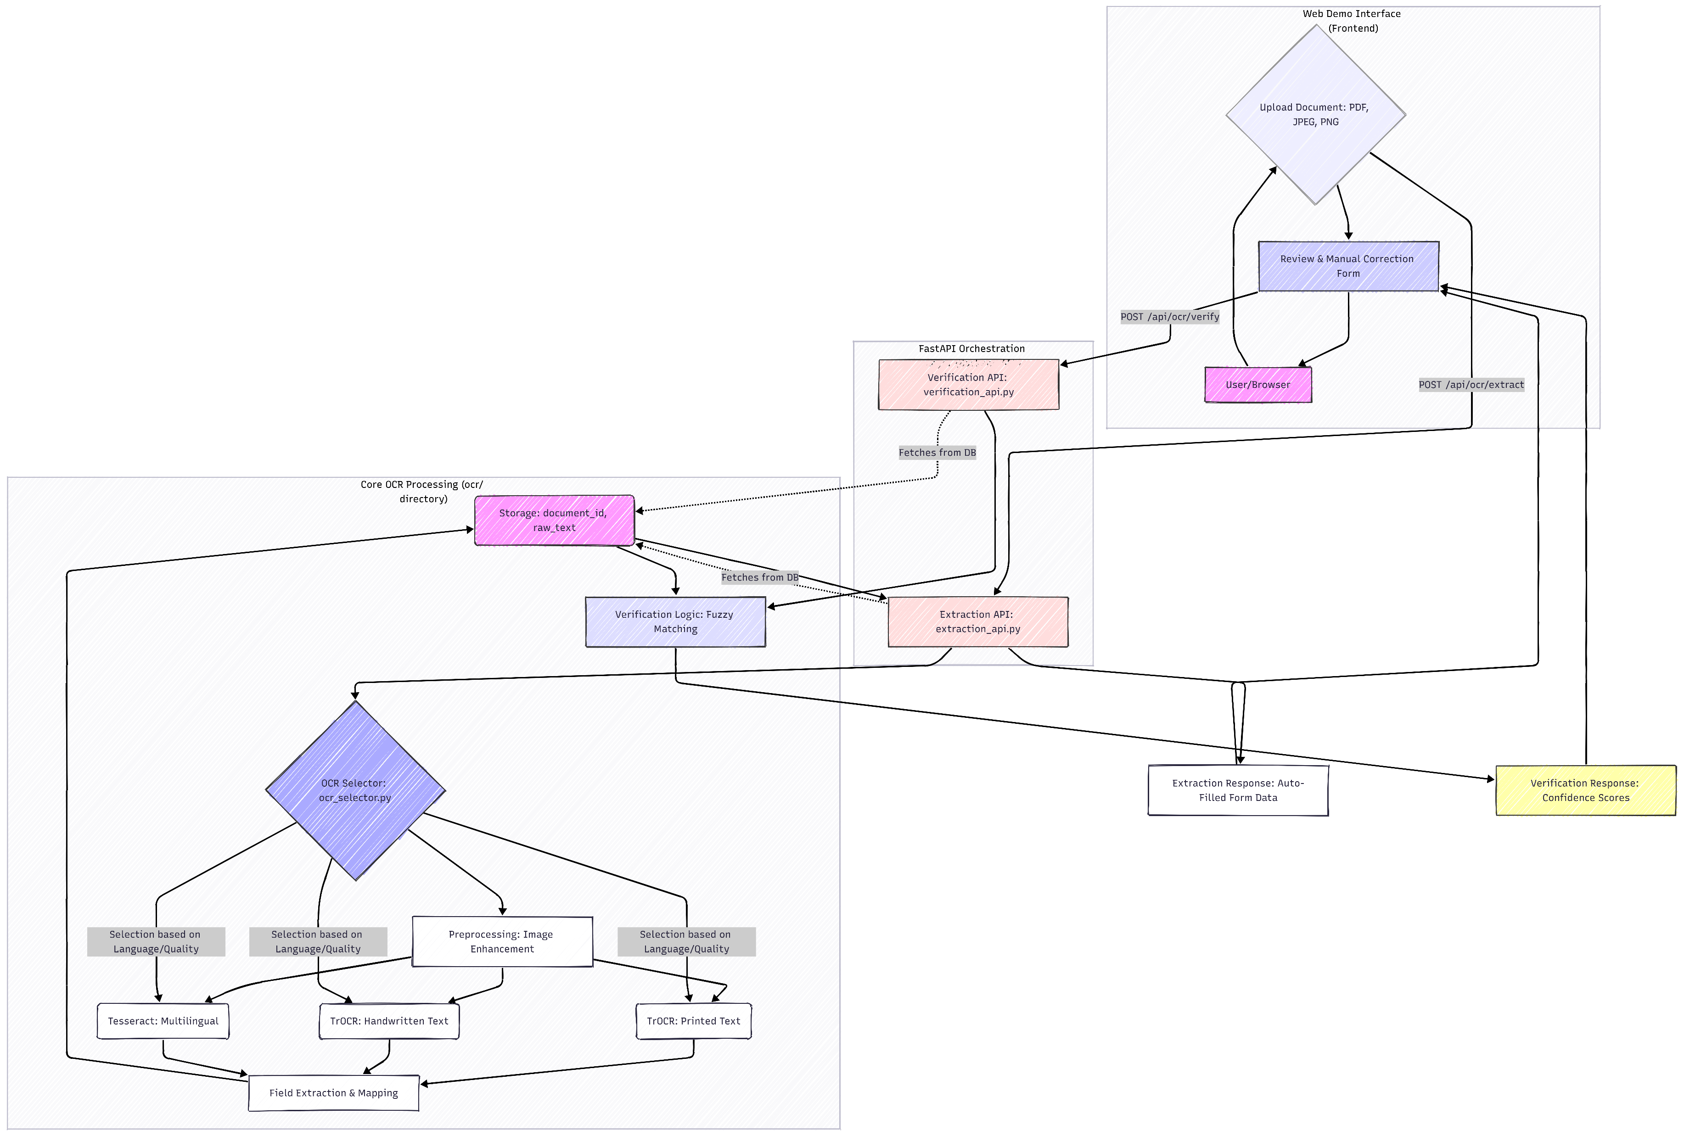
Architecture Diagram:

Slide 8
Workflow Diagram:

Slide 9
Potential Business Impact
Metric | Impact Description
Operational Efficiency | Automated Data Capture: Eliminates tedious, error-prone manual data entry for forms and ID cards.
Cost Savings | Resource Optimization: Significantly lowers the FTE hours required for data entry and validation teams.
Data Quality & Compliance | High Confidence Data: Field-level confidence scores ensure only verified, high-quality data enters core systems, improving compliance.
Scalability | Handle High Volume: The robust FastAPI backend and concurrent processing model allows the system to scale easily to handle thousands of documents per day.
Customer Experience | Faster Onboarding: Accelerates customer registration and application processing times from minutes to seconds.

Slide 10
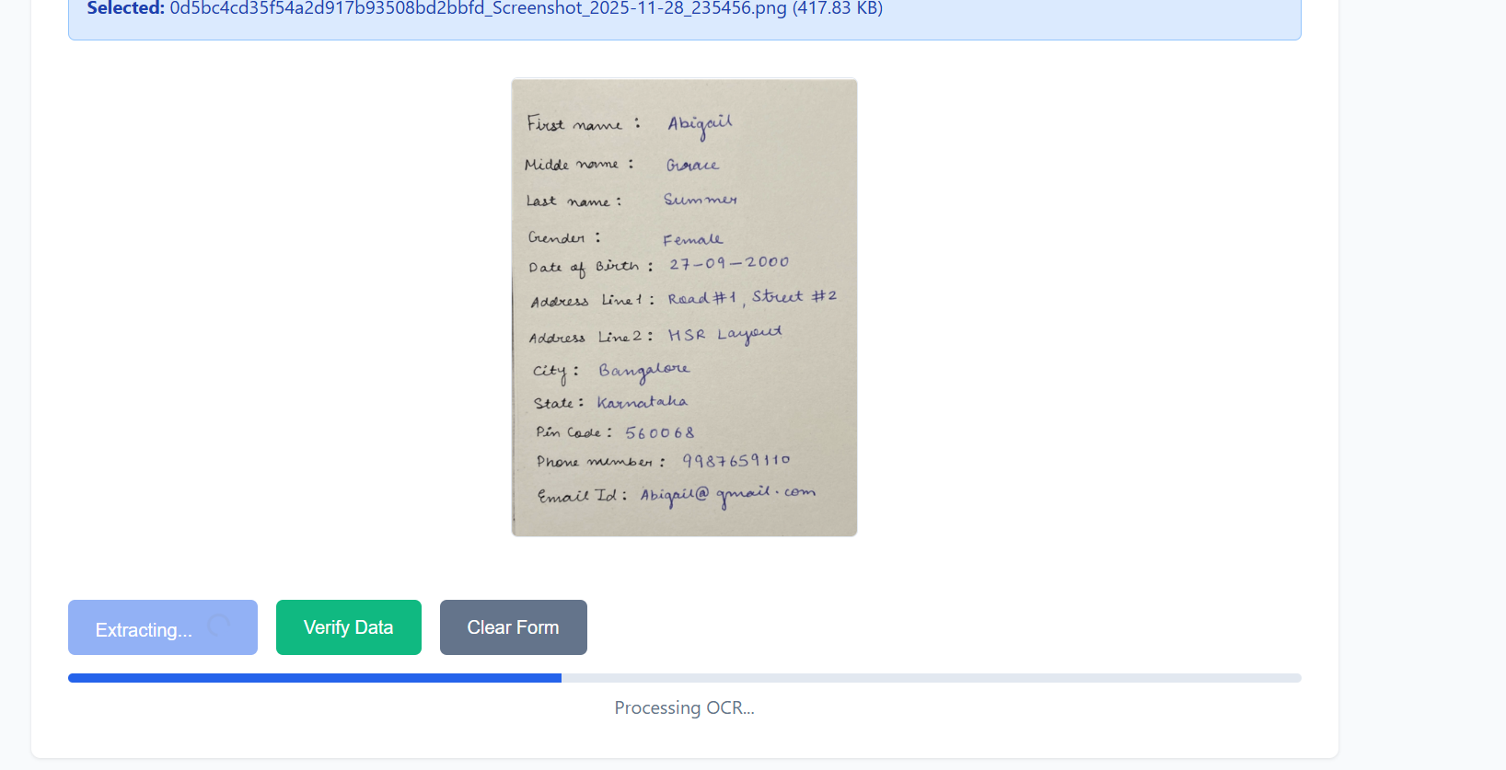
Result

Slide 11
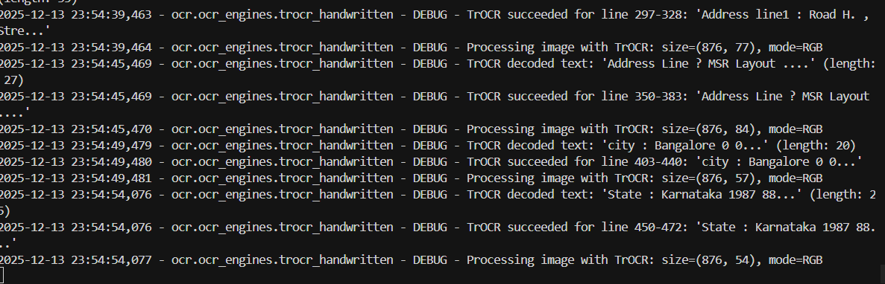
Result

Slide 12
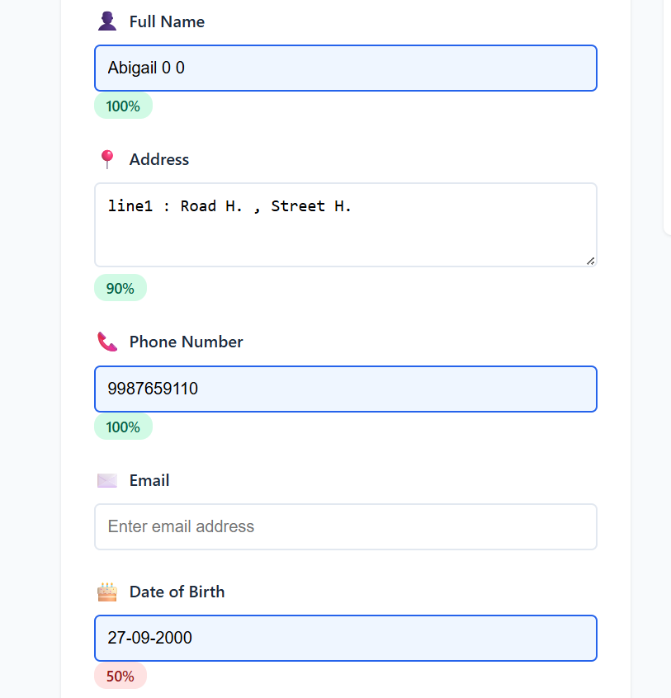
Result

Slide 13
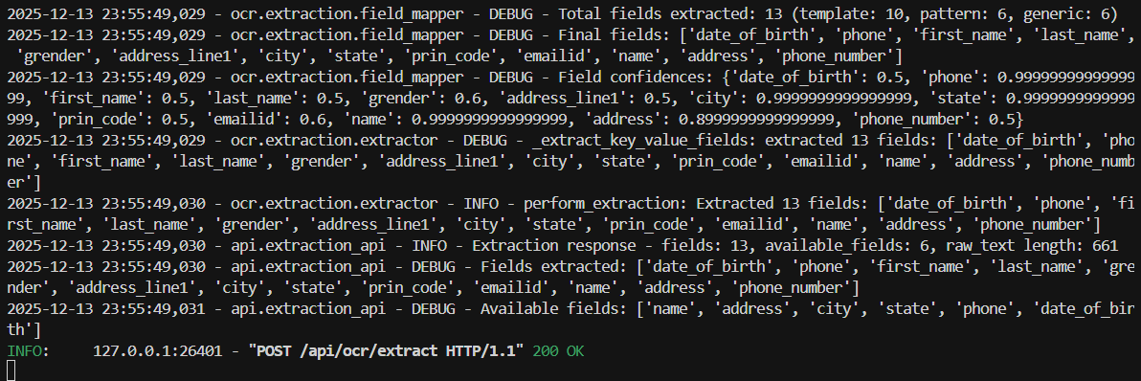
Result

Slide 14
Conclusion
Intelligent Accuracy: We have developed a state-of-the-art system utilizing TrOCR and Tesseract with a smart selector, achieving high accuracy across diverse documents and languages (English, Hindi, Arabic).
Dynamic and Flexible: The system employs Dynamic Field Mapping, meaning it successfully extracts relevant data fields without relying on fragile, fixed templates, handling variations in document layout.
Built-in Quality Control: The Data Verification API provides essential quality assurance by cross-checking extracted data and delivering objective, field-level confidence scores.

